Slide 1
The Science of Psychology & Neuroscience
Randall C. O’Reilly

Slide 2
Overview
How can we possibly use “objective” science to study the subjective mind!?
Is science even objective in the first place??
Brief history
Methods: How to get and analyze data!

Slide 3
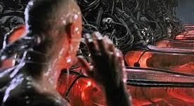
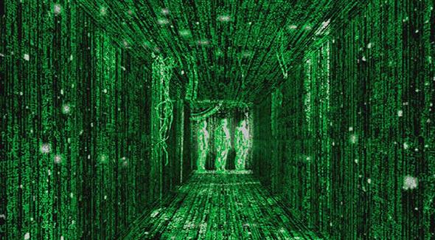
Enter the Matrix..

Slide 4
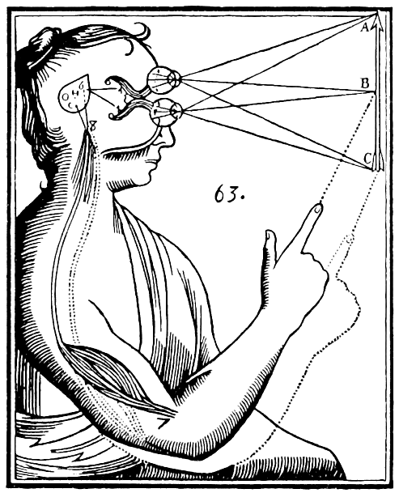
Descartes: Cogito Ergo Sum
I think, therefore I am
Subjective cognition is primary
Solipsism: subjective cognition is all there is!
Dualism: mind is separate from brain

Slide 5
Subjective / Objective Perspectives
Perspective dualism: there are 2 fundamental perspectives of the world: subjective vs. objective.
Each individual has unique subjective experience, due to properties of brain, trajectory through space & time.
But through that experience, we can construct a sense of the objective world out there, from which we can see a “third person” view of self, like everyone else sees of us..

Slide 6
Subjective Seems So Objective
The compression and predictive learning properties of the brain cause us to “transparently” perceive the world pretty darn accurately.
We have the “illusion” of objective understanding.
Some may not have even realized how subjective everything actually is..

Slide 7
My Personal Perspective
My subjective version of the objective perspective is consistent with everything I’ve experienced, and makes sense to me.
In particular, my own subjective experience makes sense in terms of my objective knowledge of the brain.
I’m satisfied, if not particularly “happy” with being my brain..

Slide 8
Simulation Hypothesis
Arguments for:
- Bostrom, Musk, et al: Technology will get so much better (if we survive), will have simulations indistinguishable from reality. So many of these would be possible, odds are we’re in one..
Arguments against:
- Carroll: Self-contradiction: we most likely live in “bottom level” of simulated realities, where such simulations are not possible..
- Poundstone: Time contradiction: Why is our simulation of a time when we don’t have sub-simulations?
- Kipping: Bayesian math says odds of reality > .5:
https://www.youtube.com/watch?v=HA5YuwvJkpQ

Slide 9
My Take: Too Hard to Keep Story Straight
Everyone assumes you can just get by with simulating an individual’s perception, which is waaaaaay simpler than simulating entire universe -- if you have to simulate the universe, then it takes at least a universe... Who cares!?
But how many shortcuts can you actually take, without creating such a contradictory mess, that it would be obvious?
They assume you could just rewrite memories for every mistake, but that assumes a very naïve modular form of memory – isolated little flashbacks like in movies: in fact memory is a massively interwoven network and trying to alter just one part would be very difficult.
And I can go to a library (i.e., the internet) and randomly lookup millions of sources of data, that all tell a consistent story at some level. This story includes the results of experiments that depend on geological and celestial events going back millions and billions of years. Science, and physics, is constantly working.
Getting all that right, without actually just running the universe itself, seems incredibly, incredibly hard. With no real point – even if someone could, why would they? The universe is likely infinite, so just go explore more of it.

Slide 10
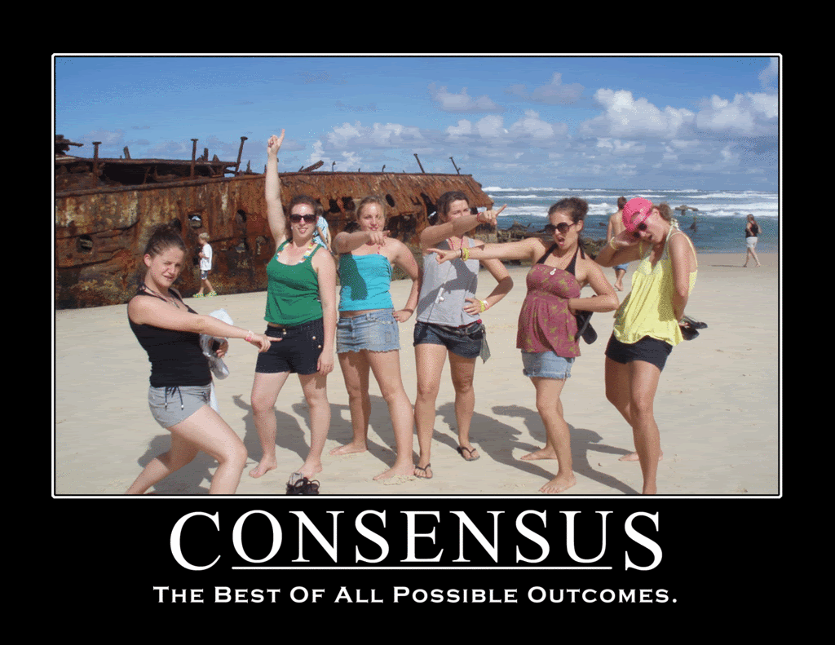

Slide 11
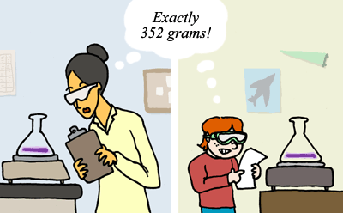
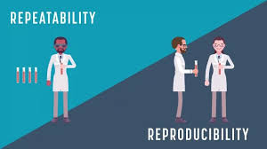
Reproducibility = Consensus

Slide 12
The Scientific Method
Have a question / informal observation,
Form a hypothesis, with testable predictions
Collect data, using reproducible procedures
Analyze data: does it support predictions, beyond level of random chance / noise?
Draw conclusions.

Slide 13
The Scientific Method: Critique
make an observation,
form a hypothesis (based on what??)
collect data,
analyze data,
draw conclusions. (yeah, like what??)
Hypotheses and conclusions are subjective, psychological constructs!!*
*Don’t even get me started about measurement in quantum physics!

Slide 14
Consistency (of pudding*..)
Good hypotheses are those that are consistent with good theories, and good theories are those that tie together a large number of observations under a single, hopefully relatively simple, consistent framework.
* The brain

Slide 15
Summary: Science is Hard, Imperfect
And so are relationships, and everything else having to do with actual people..
Psychology is actually the key to really understanding actual science, at many levels.

Slide 16


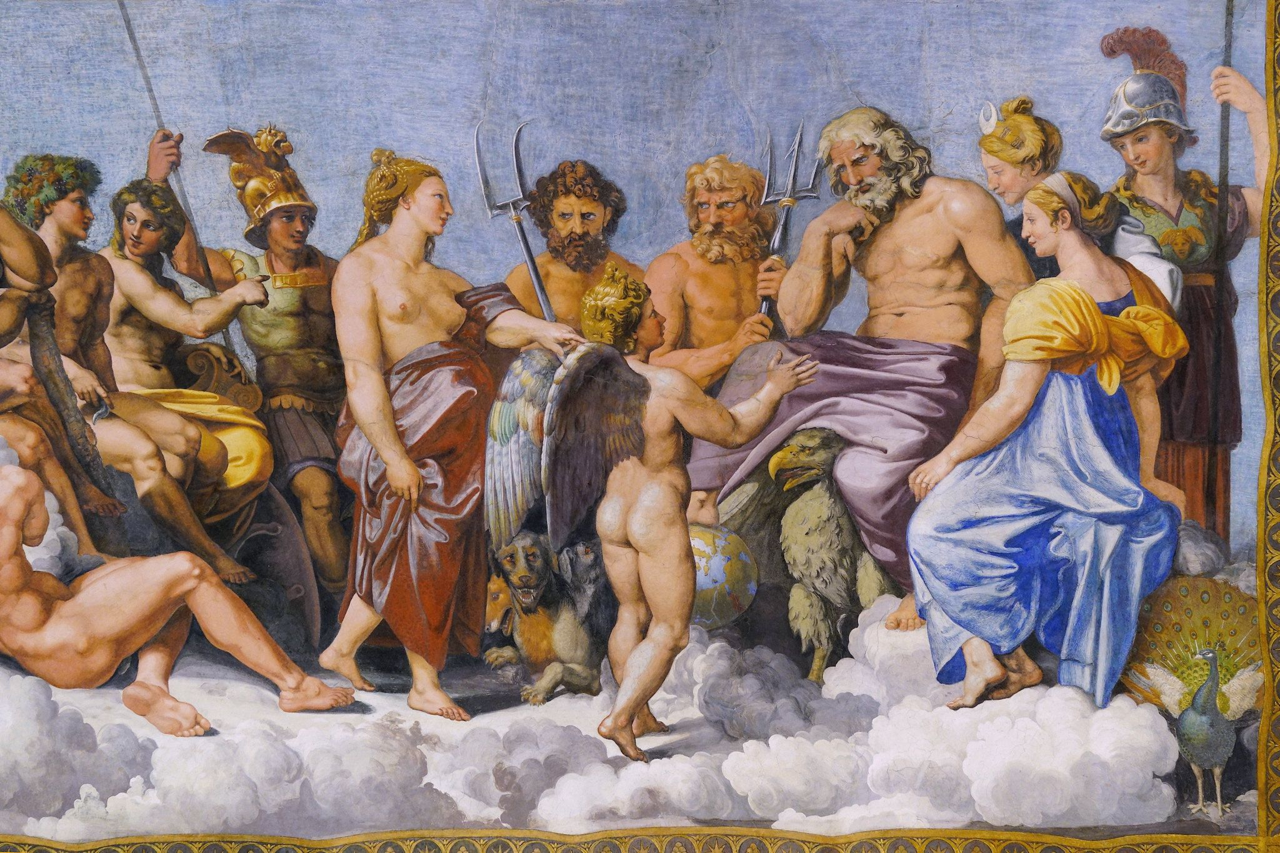
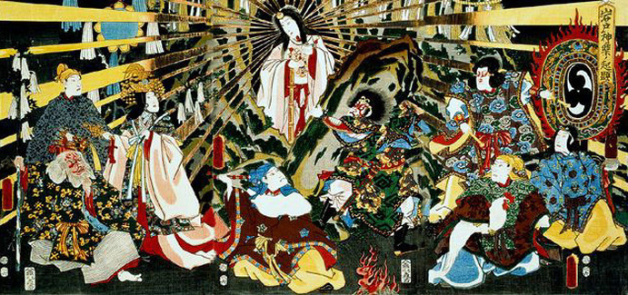
In the Beginning: All was Spirit..
<- India Africa v
All was spirit and void..
<- Roman Japan ^

Slide 17
No Harm in Trying: The History of Psychology
No Psychology in the Ancient World. But plenty of Philosophy!
Buddha: Suffering = patterns of thoughts, proscribed treatment (lose the attachments!)

Slide 18
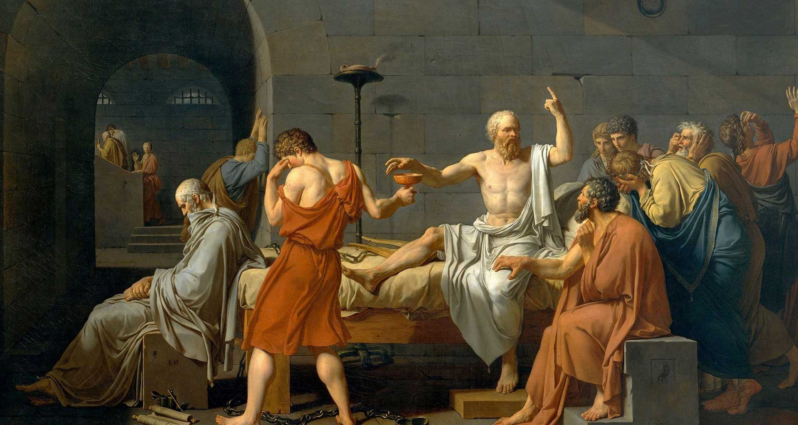
Ancient Greek Philosophy
Where / what is the mind? Reality real (Plato’s Cave)
Nature vs. Nurture / Empiricism
Reason, Logic vs. Empiricism
Thought <-> Emotion

Slide 19
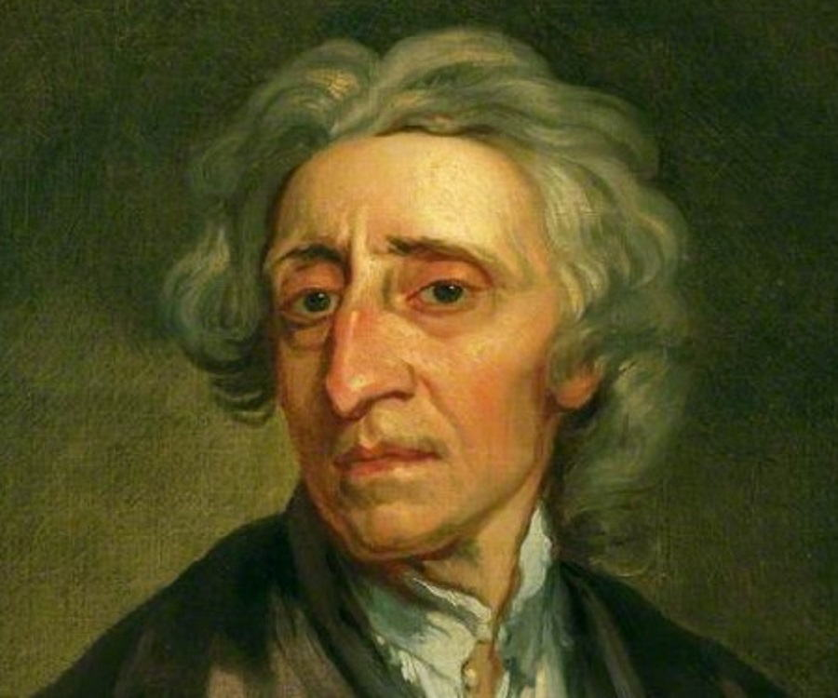
Rationalism vs. Empiricism
Rationalism: Deduce what is true based on logical principles, axioms, etc. (Descartes)
Empiricism: Learn what is true based on experience. (Locke)
Can’t we all just get along!?
Clearly you need both..

Slide 20
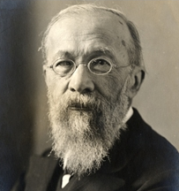
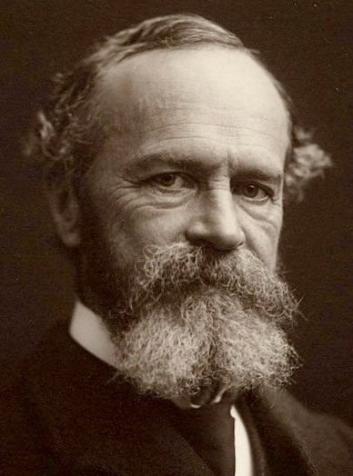
Hey, How about some Data!
Wilhelm Wundt (1879):
First to collect scientific data about human behavior! i.e., the first true Psychologist.
But unfortunately, the data was all subjective!
Titchener: structuralism = subjective contents of experience, through introspection
James: functionalism = largely theoretical (vs. experimental) ideas on specific functions of mind (not contents).

Slide 21
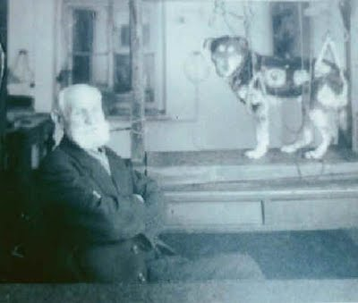
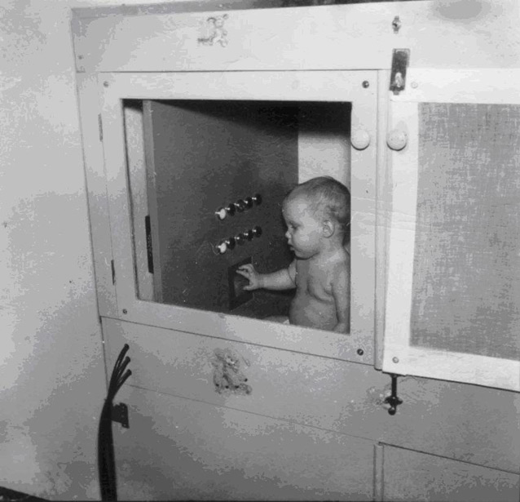
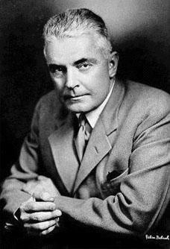
Hey, How about some Objective Data! (1913-1950’s)
Behaviorists: rejection of introspection – can only study and theorize about what is objectively observable: behavior! Stimulus -> Response
Pavlov
Skinner
Watson

Slide 22
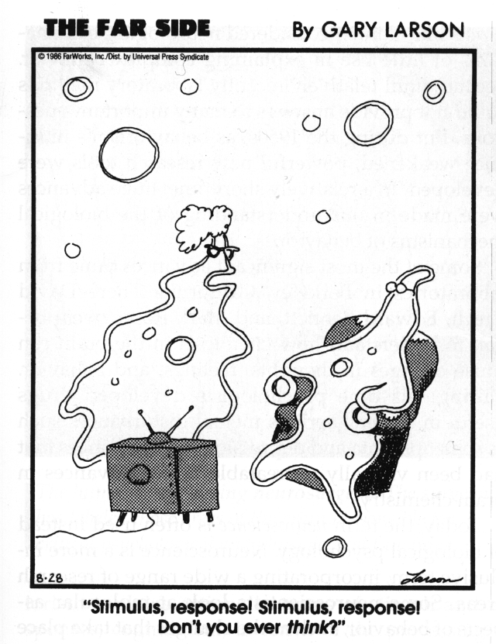
Cognitive Counter-Revolution (1960’s)
Cognitive(ism): Yeah, maybe there is actually something going on inside the mind..

Slide 23
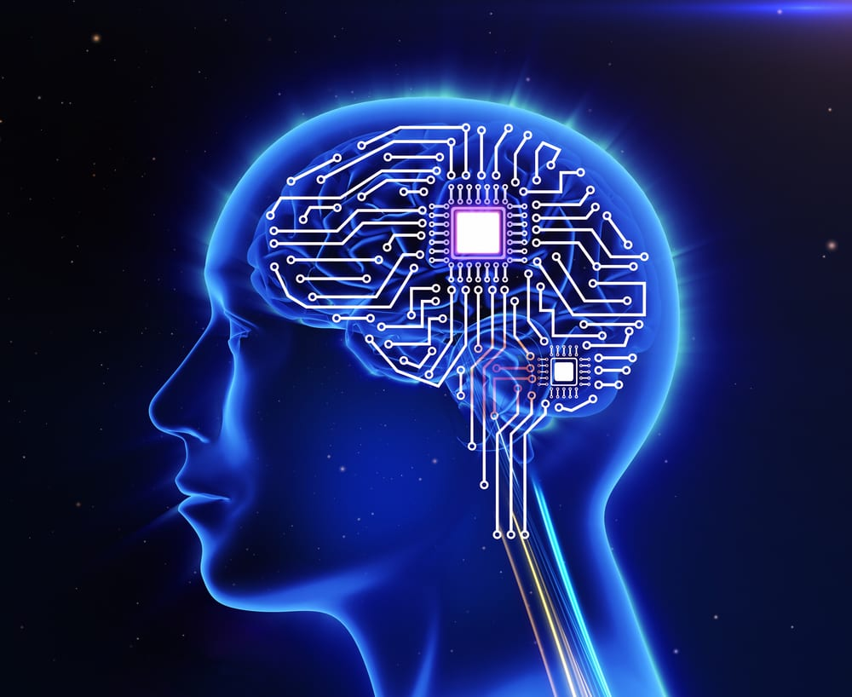
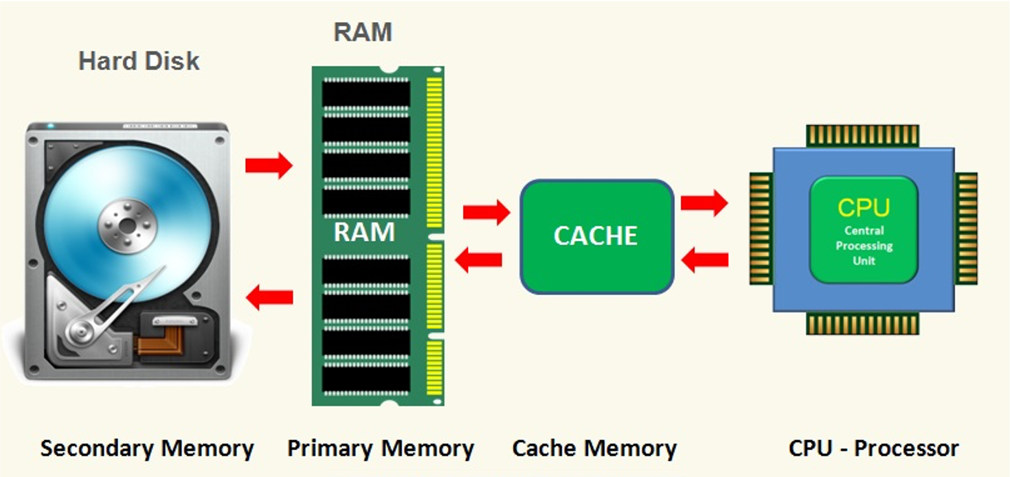
Mind as Computer
Behaviorism:
Cognitive Psychology:
Stimuli
Responses
Stimuli
Mental Processes
Responses

Slide 24
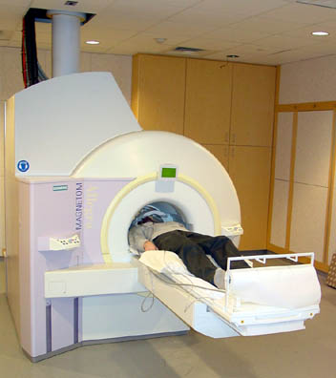
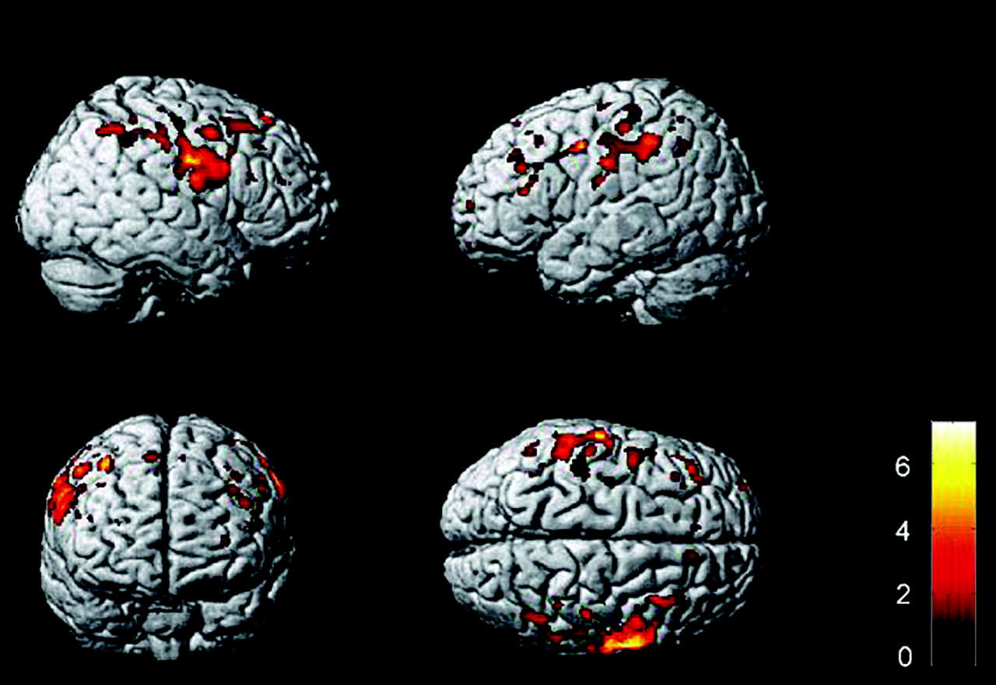
Enter the Brain..
1960’s-80’s: Cognitive “boxology” based on idea that mind is a digital computer
1990’s – now: Cognitive Neuroscience!

Slide 25
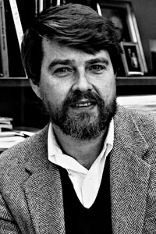
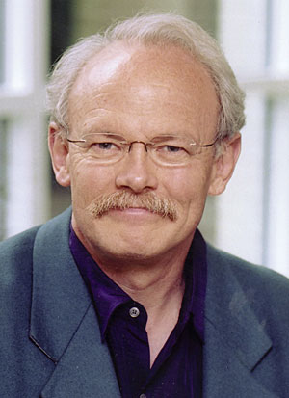
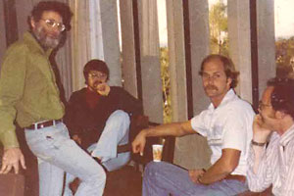
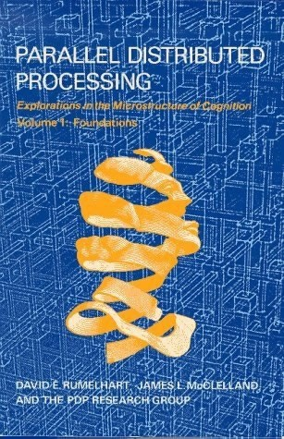
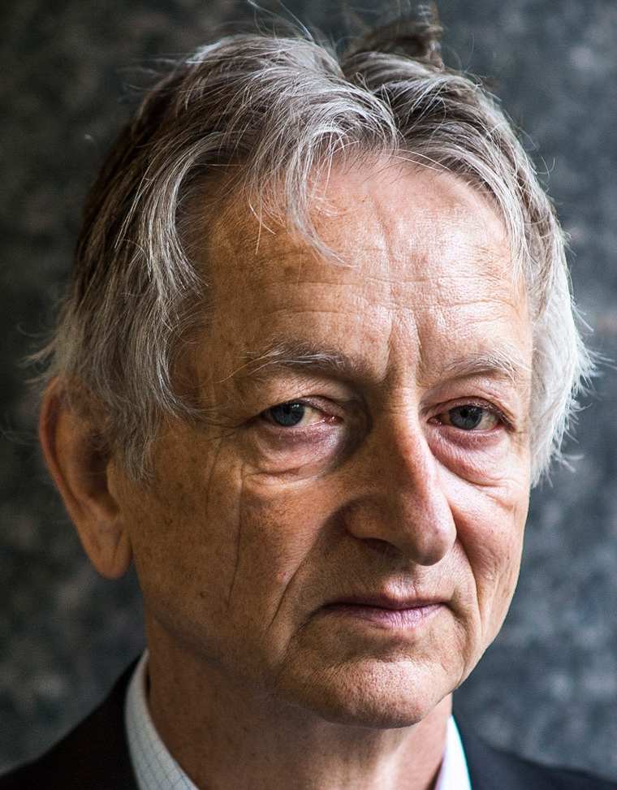
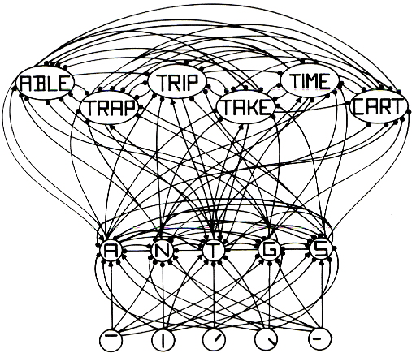
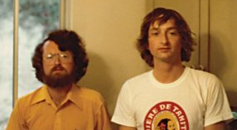
Neural Networks (Rumelhart & McClelland, Hinton)
Psychology:
currently taking the AI world by storm, 30 years later…

Slide 26
It took a while, but..
We now have a mature science based on objective data about both behavior and the brain mechanisms that give rise to it!
Internal cognitive processes can be objectively measured in many ways, instead of just making stuff up about how computers might do stuff..

Slide 27
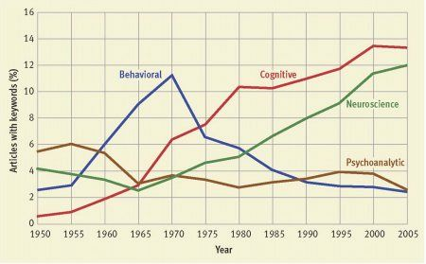
Paradigm Trends

Slide 28
Other Historical Trends
Freud and psychoanalysis (1900-1920):
role of the unconscious, tripartite structure: id, ego, superego
Gestalt psychology (1910-1940)
Whole is different than sum of its parts: emergence!
Rogers, Maslow: Humanism (1950’s – now)
Motivation, individual feelings, potential for growth
Piaget: Developmental Stages, etc (1960’s)
And many others..

Slide 29
Crazy Science vs. Sane Science
Crazy: all the different theories!
It’s all just S->R? Mind is a digital computer?
Sane: all the data that was generated.
S->R learning data still very relevant.
Cognitive info processing data very relevant..

Slide 30
Scientific Methods
Descriptive: good: doesn’t interfere (“naturalistic”) bad: weak data – what are variables?
Correlational: good: also “naturalistic”, has variables. bad: no causality: the third variable problem!
Experimental: good: causal relationship between vars! bad: requires random assignment (impossible for many important questions), “artificial” lab studies: poor external validity

Slide 31
Real-world Scenario
Hypothesis: my romantic partner is cheating on me.
How do you determine if it is true or not?

Slide 32
Methods in Action
Descriptive: observe behavior, note who they are hanging out with, paying attention to, whether they’re acting strange / distant around me..
Correlational: plot frequency of sex, fights, good times, bad times over time: have things changed?
Experimental: probe them with challenging questions: “do you love those others as much as me?” – see how they react.. Get a “friend” to try to sleep with them..

Slide 33
Pros / Cons
Descriptive: good: doesn’t raise any suspicions (“naturalistic”) bad: not much to go on..
Correlational: good: also “naturalistic” (no suspicions), more precise understanding of data. bad: other factors at work! e.g., old marrieds, etc the third variable problem: correlation does not equal causation!!
Experimental: good: could catch them in the act! bad: create false truth! e.g., bad questions = bad answers external validity

Slide 34
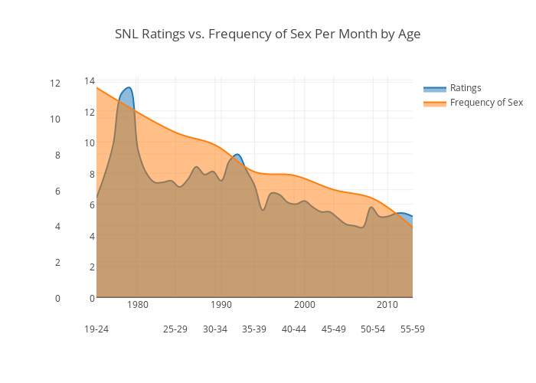
Correlational Truth?

Slide 35
Statistics
Descriptive: mean, median, mode, std deviation
Correlation: scatterplots
Experiments: t-test, ANOVA (F)

Slide 36
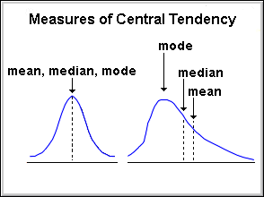
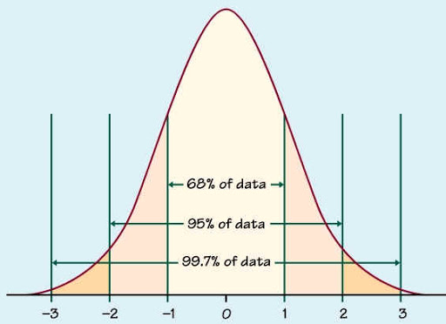
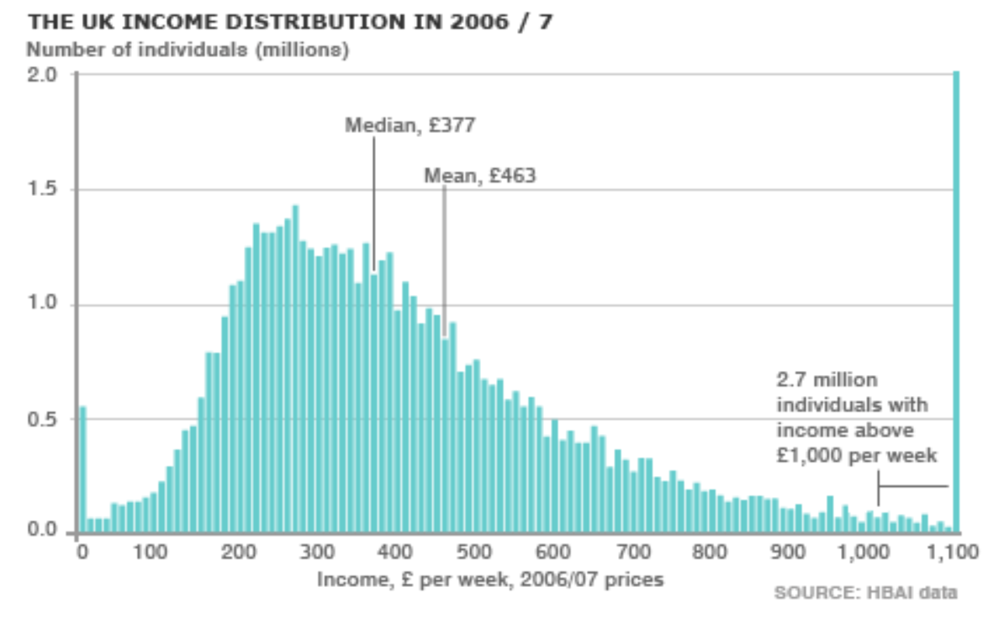
Descriptive Statistics
Standard Deviations

Slide 37
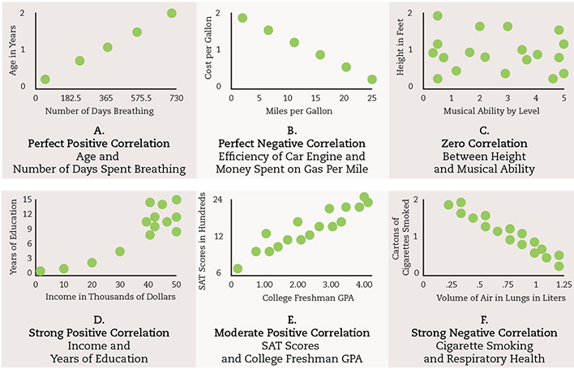
Correlations: Scatterplot

Slide 38
Correlation != Causation
EVERYBODY gets this wrong!
http://www.tylervigen.com/

Slide 39
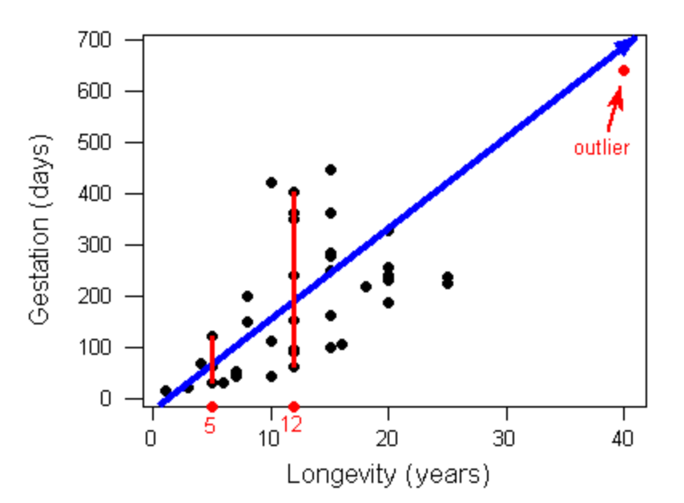
Beware of Outliers (super data influencers)

Slide 40
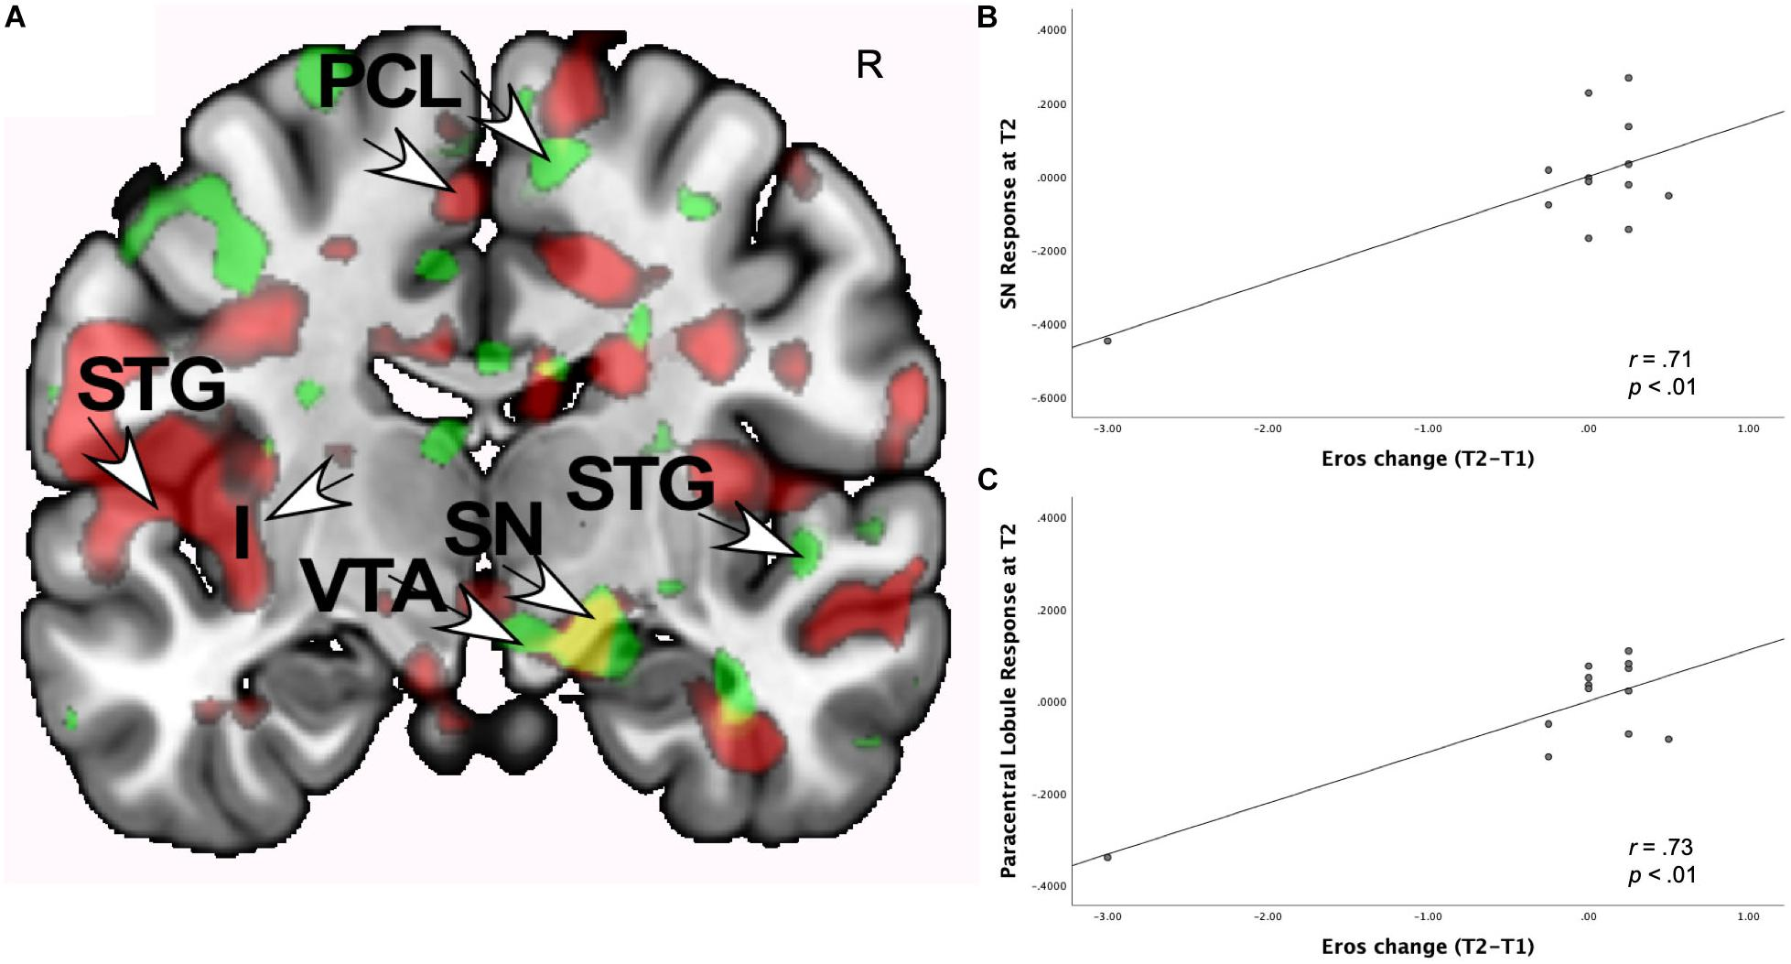
Neuroimaging is Correlational (Neural correlates of Romantic Love..; Acevedo et al, 2020)
Note the massive outlier!

Slide 41
True Experiments
Avoids 3rd variable problem, determines true causal relationships!
Random assignment to conditions
Avoids 3rd variable of pre-existing conditions..
1 or more control conditions
Must compare manipulation to something
Control over confounds
Eliminate all possible other 3rd variables

Slide 42
Possible subjects
Experimental Group
Random assignment controls for differences
Control
Group
Study and testing conditions
Identical conditions
control extraneous
variables
Study and testing conditions
Music
Independent variable
(Cause)
No
Music
Behavior
(test scores)
Behavior
(test scores)
Dependent variable
(Effect)
Is there a difference?

Slide 43
Experimental Design
Independent variable: manipulated, cause
e.g., does coffee improve learning?
it’s the (amount of) coffee!
Dependent variable: measured, effect
measure of learning: post test – pre test

Slide 44
Inferential Statistics
Is observed difference unlikely to be due to chance?
e.g., drug A is more effective than B, p < .05 that this is due to chance in the random sample I happened to encounter in my study.
t-Test: developed to test Guiness beer!
F-Test, ANOVA: multiple factors
GLM: generalized linear model – works for everything!

Slide 45
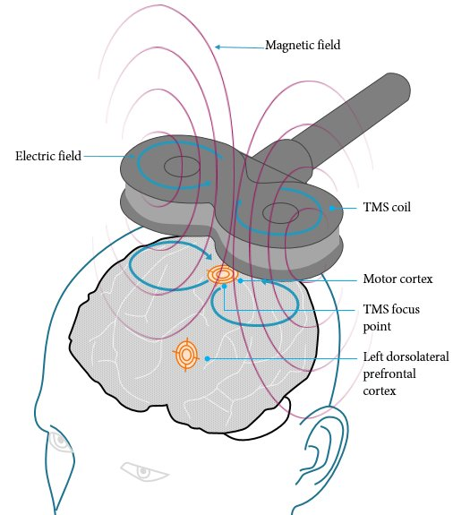
Causal Neuroscience
Transcranial Magnetic Stimulation: TMS
Good: causally affects brain function (“temporary lesion”)
Bad: artificial brain stimulation / inhibition – not simple lesion – introduces new activity

Slide 46
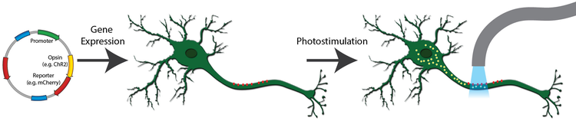
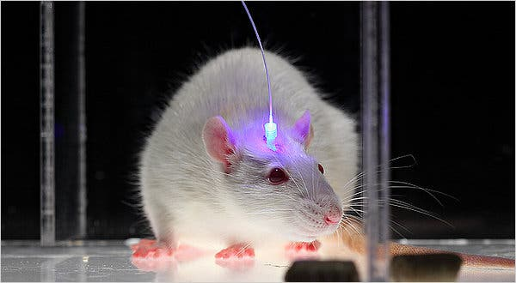
Optogenetics: Cell-specific Excitation / Inhibition

Slide 47
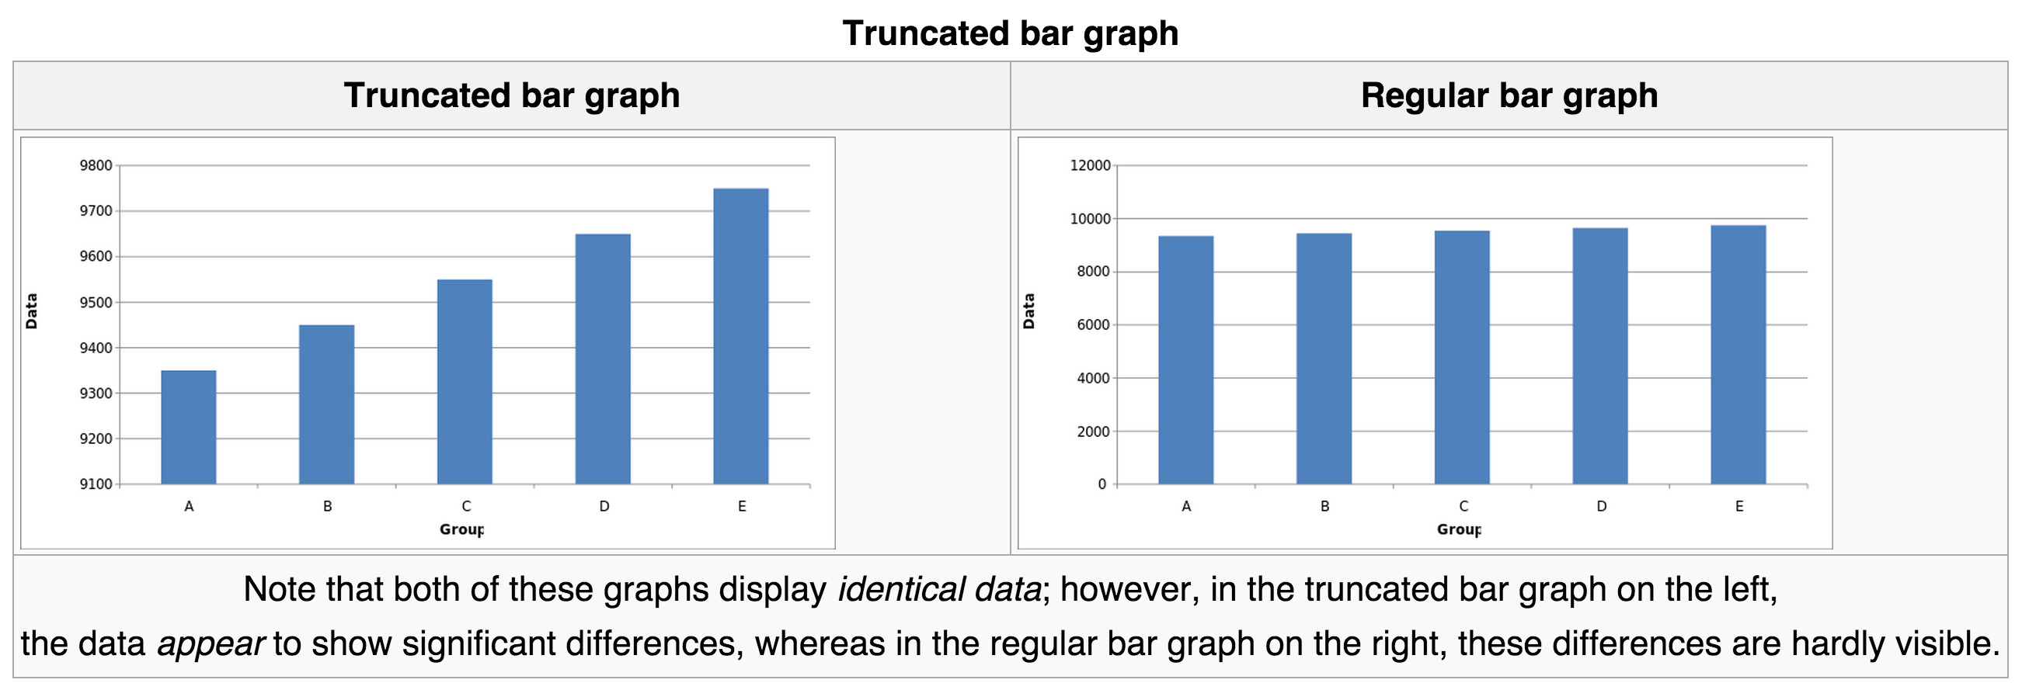
Damned Lies..
Beware of percentages! 100% of nothing is still.. Nothing!

Slide 48
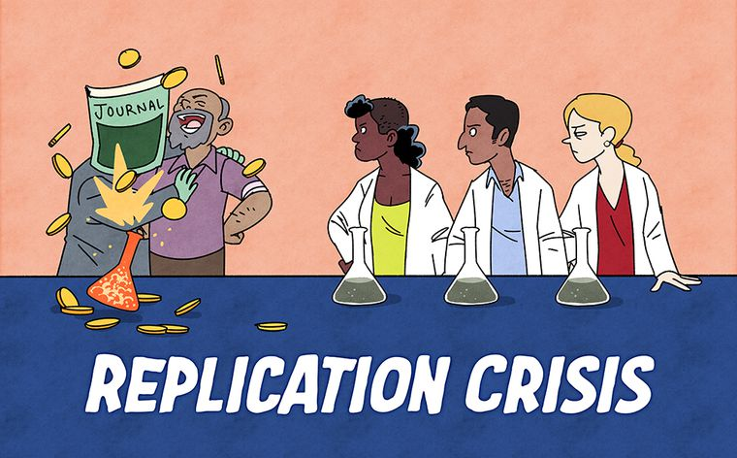
Many biases in favor of positive results, against negative: p < .05 is more like p < 0.5 is due to chance

Slide 49
Critical Thinking!
Be aware of your biases, and their biases
Look carefully at the data – the actual data, not just summary stats, graphs, etc
Correlation != causation

Slide 50
Human Subjects Protections
get permission from ethics committee
informed consent
right to terminate at any time
legal age (18)
procedures/risks
confidentiality
debrief
(IF risk, weigh risk/benefit ratio.)

Slide 51
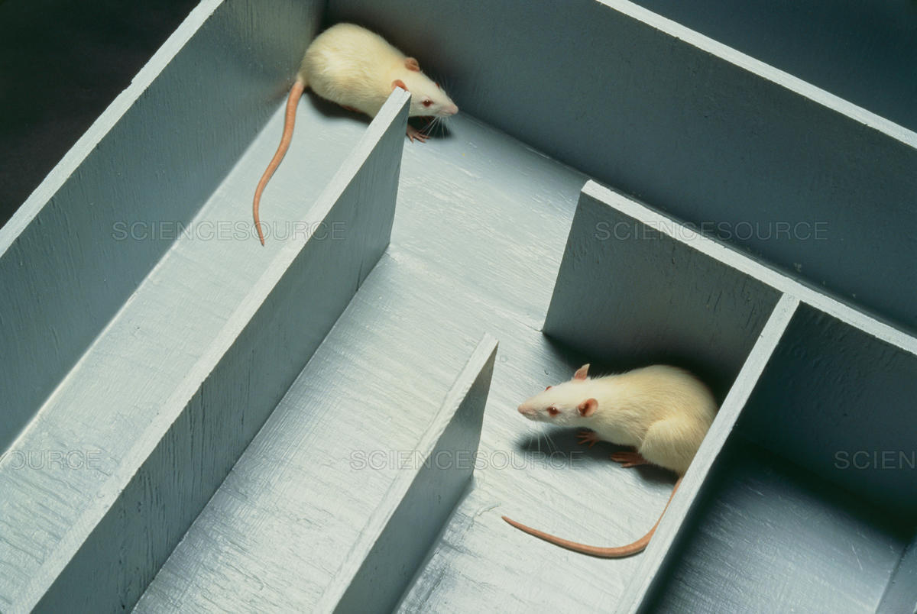
Animal Subjects Protections
must get permission from ethics committee
comfort, health, humane treatment

